Slide 1
My Brain is Fabulous!
I can think with my brain!
By Ms. Boulais, Instructional Coach
Eastbrook Elementary
MSD Pike Township

Slide 2
Lesson 1
What we know about our brain and how to make it stronger

Slide 3

I have a brain inside my head.

Slide 4
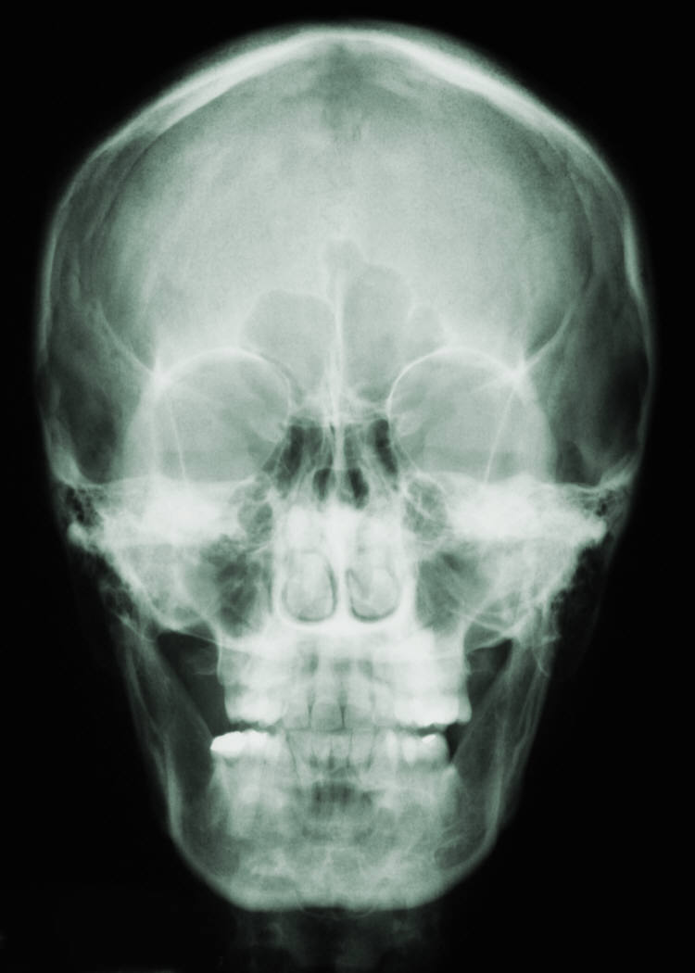

My brain is here inside.
My cranium protects my brain.

Slide 5
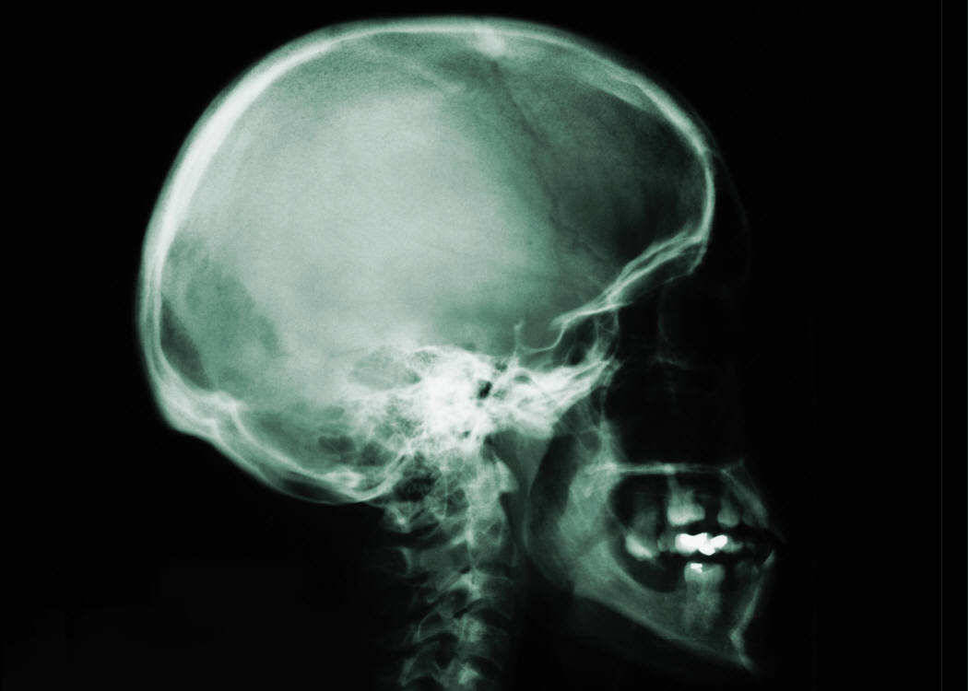
Before I was born my brain wasn’t finished growing.

Slide 6
It helps me think.
…and make good choices.
I love my brain even though
it looks strange.
I makes me different from
… from a robot because
I can feel and have emotions.

Slide 7
My brain weighs about 3 pounds!
That’s as much as toaster!

Slide 8
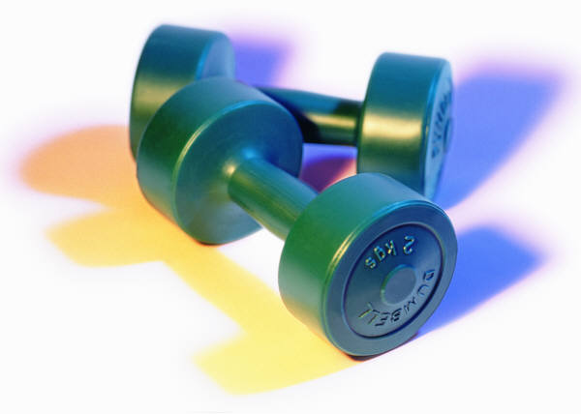
Three pounds=

Slide 9
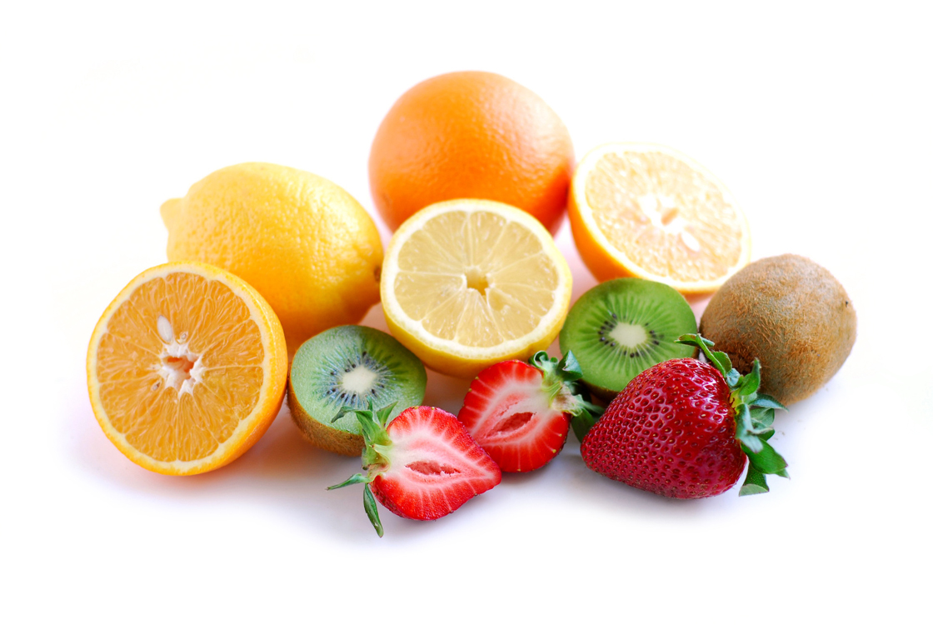
Our brain needs good foods!

Slide 10
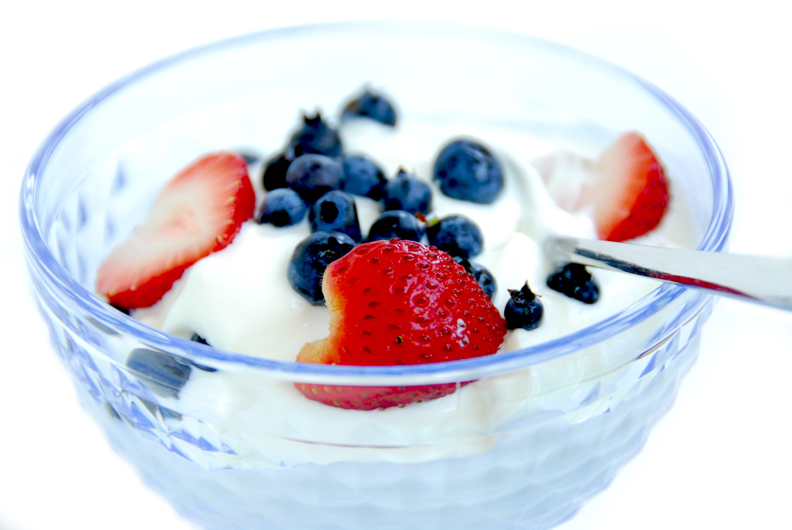
Blueberries and strawberries
are good foods for our brains!

Slide 11
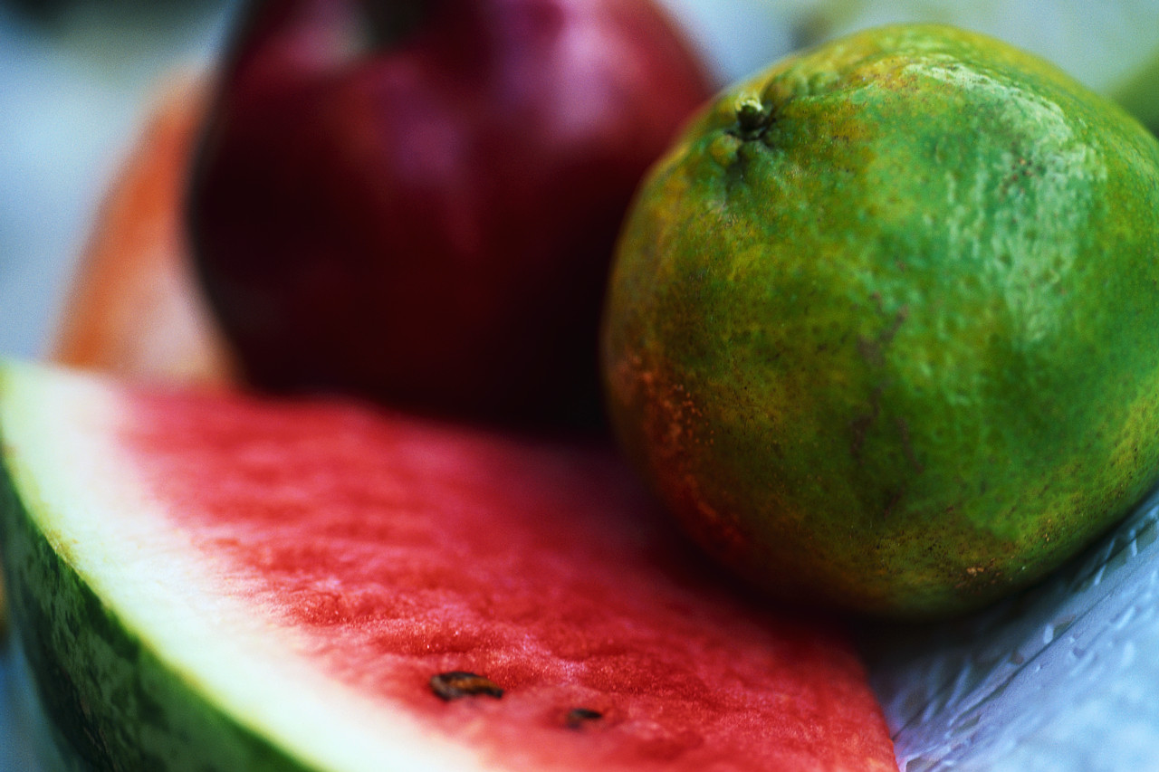
Apples, limes, and watermelon
Yummy fruits for my brain!

Slide 12
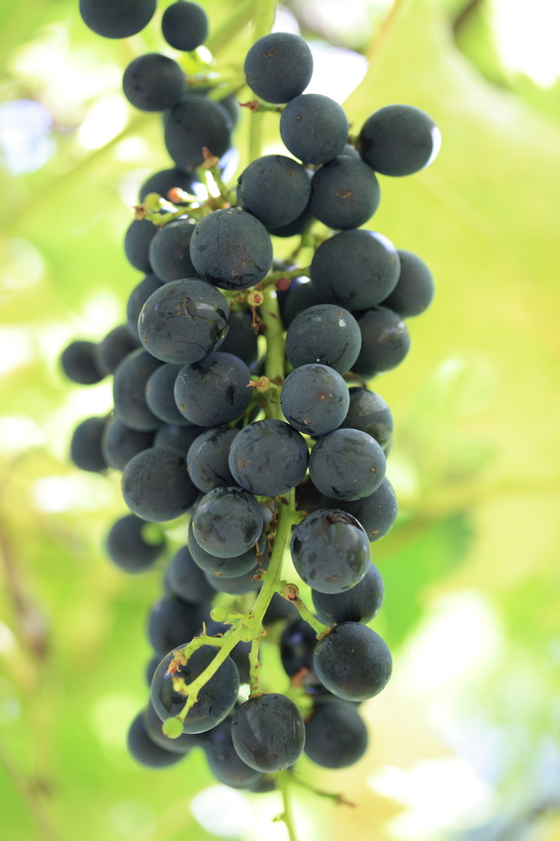
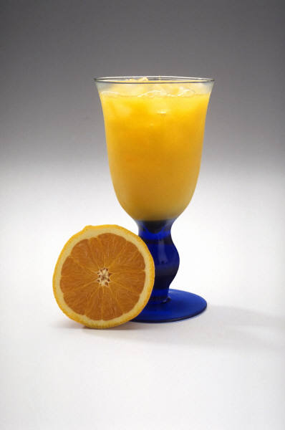
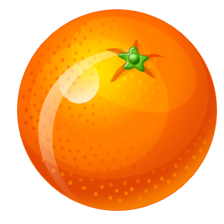
These foods make your brain strong!

Slide 13
More foods to make our brains …
POWERFUL!

Slide 14
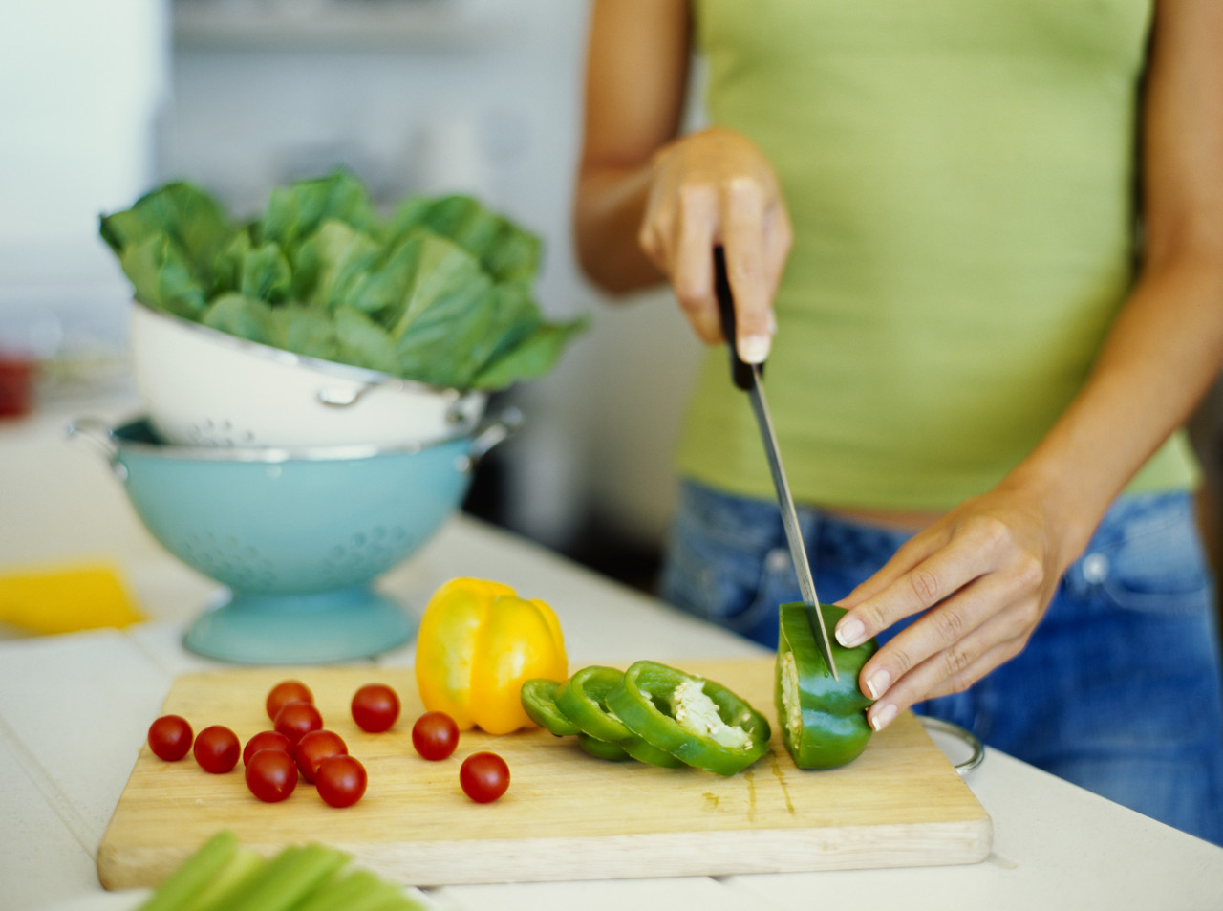
Yummy Brain Food!

Slide 15
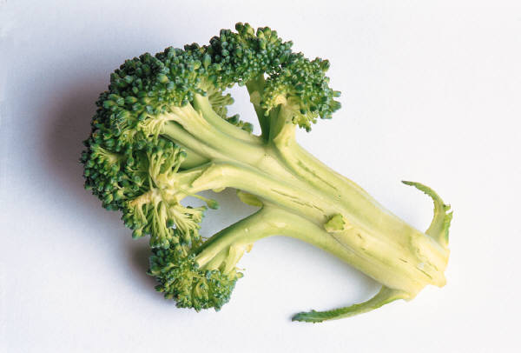
Broccoli

Slide 16
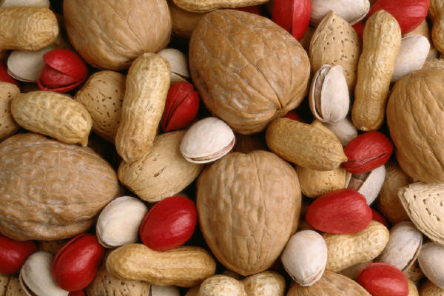
Walnuts, almonds and green tea are also fabulous for your brain!

Slide 17
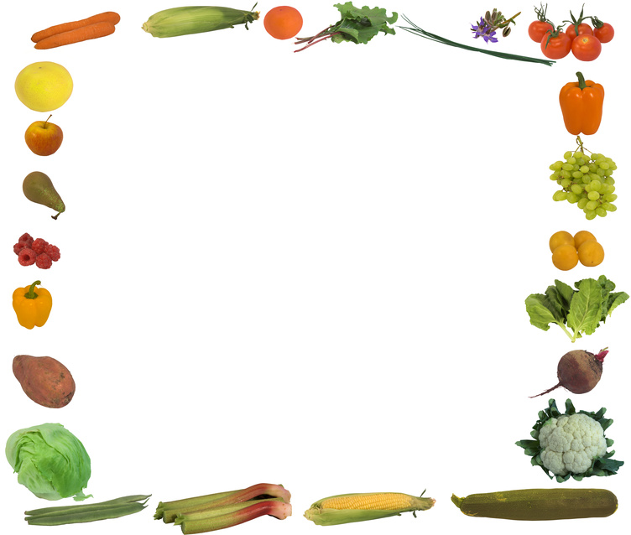
All of these are fabulous brain foods!

Slide 18
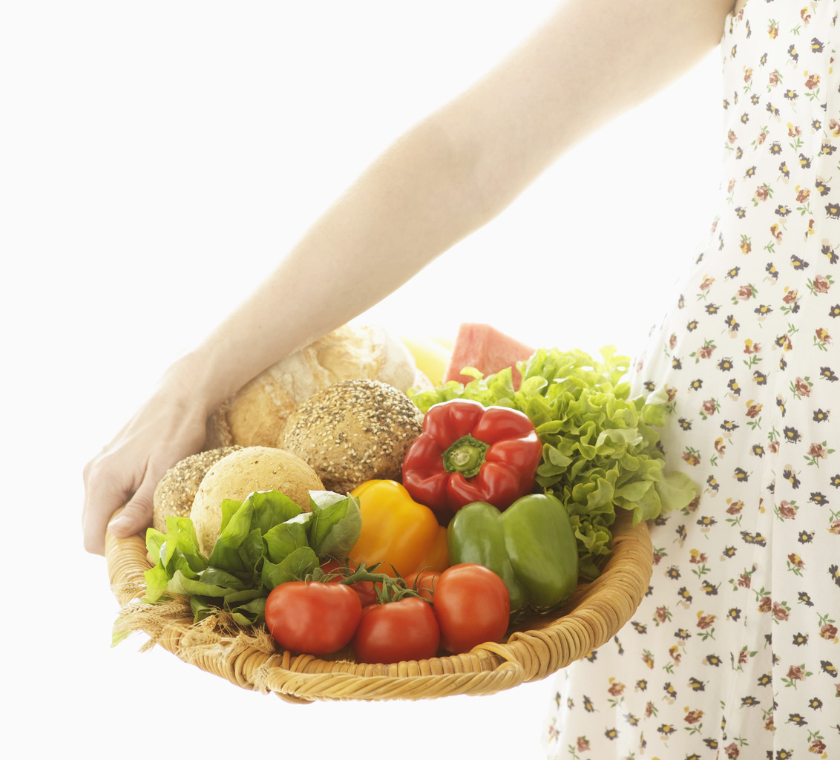
What do you notice…
about brain foods?

Slide 19
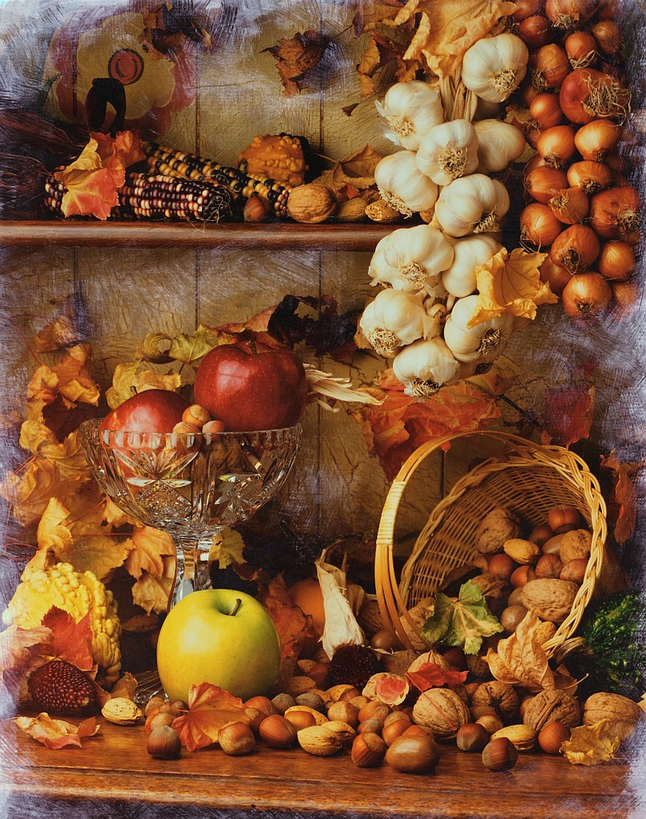
They are all Fruits and Vegetables!
Plants!

Slide 20
Lesson 2
The parts of your brain and watering the brain.

Slide 21
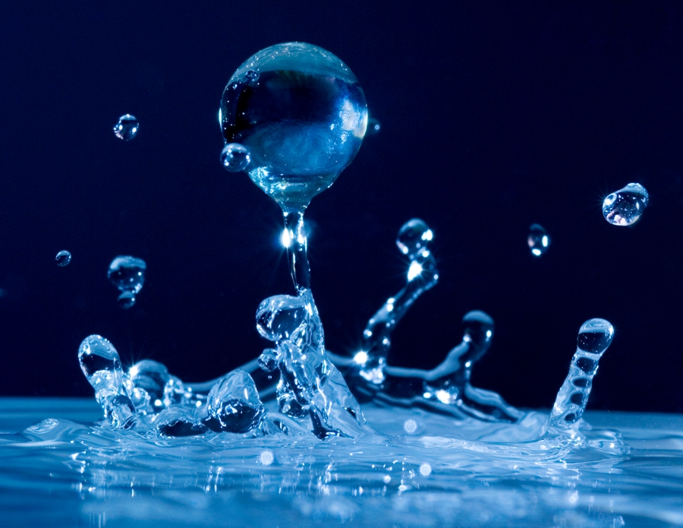
Did you know…

Slide 22

Your brain needs 2 glasses of water for every 25 pounds you weigh!

Slide 23
Now kiss your ….

Slide 24
Lesson 3
Two Important Parts of Your Brain
The parts of your brain
Inside

Slide 25
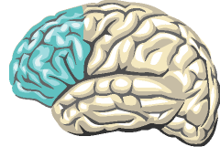
Prefrontal Cortex is thinking part of my brain and it is at the front of my head. It is here that I make decisions about my life.

Slide 26
When I think, my body moves. It sends signals throughout my body like a train!

Slide 27
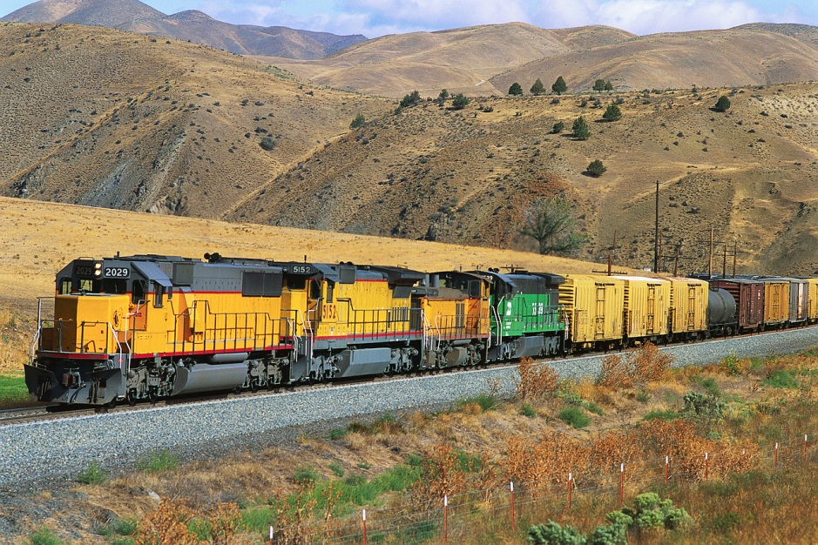
My brain is in charge of my body!
It is powerful like the engine of a train.
My brain controls my heart beating and my movements as well!

Slide 28
I am thinking!!!!!
This part helps me think about my behavior and make good choices! I love my prefrontal cortex!

Slide 29
It helps you control your behavior, think about problems, make right and wrong choices, and think about the consequences of your actions.
What’s a consequence?

Slide 30
A consequence is what happens when we make a choice whether it is good or bad.

Slide 31

Making Choices Can be Tricky!
Should I do this or that?

Slide 32

Hmm….should I be in the road?

Slide 33
Stay in my yard or listen to my parents?

Slide 34
My prefrontal cortex helps me control my behavior.

Slide 35
Lesson 4
My Prefrontal Cortex controls my long and short term memory.

Slide 36

It also helps me to plan and stay organized.

Slide 37
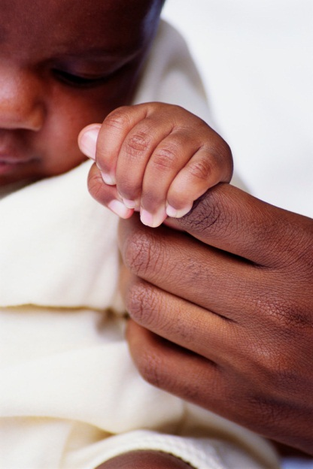
And guess what?
It helps me remember things from a long time ago and from what my teacher says today.

Slide 38
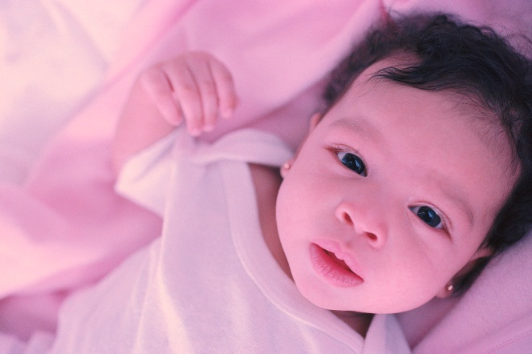

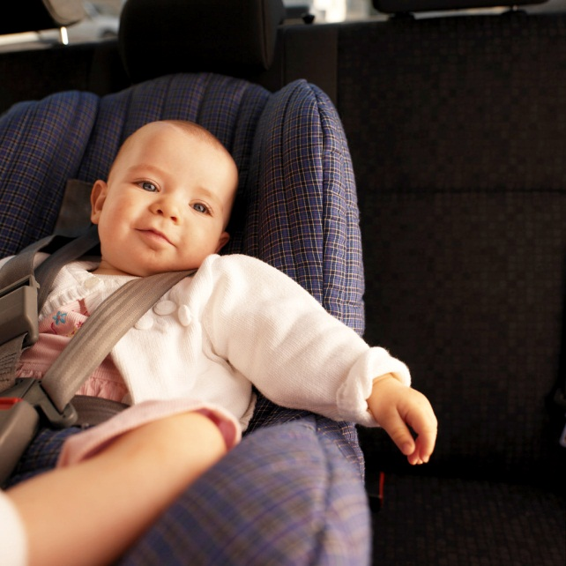
My son Andre’s Story…

Slide 39
Part Three=3
How can my brain help me in school?

Slide 40

Inside my brain is the Limbic System

Slide 41
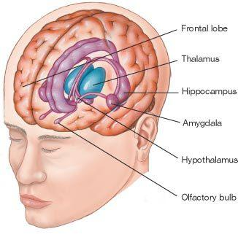
Little parts work together inside my brain. It’s a system!

Slide 42

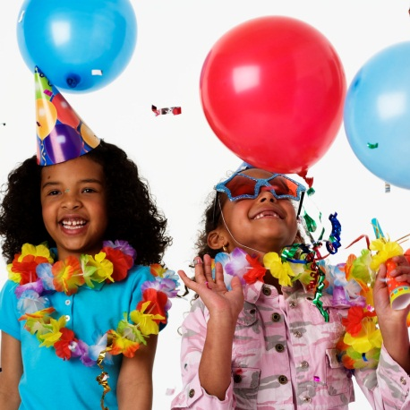
Limbic System
This is the area of the brain where we feel anger, fear, and pleasure.
Why would we need these for survival?

Slide 43

Limbic System connects us to emotions…our feelings

Slide 44
Hippocompas and Amygdala

Slide 45
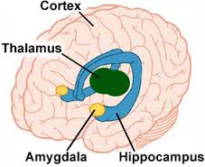
Amygdala -The amygdala is responsible for determining what memories are stored in your brain

Slide 46
Hippocampus
Helps us with our long term memories and our short term memories.
Hmmm how can that help us in school?
ABCDEFGHIJKL MN
OP QRS TUV WXYZ
12345678910 11 12 13 14 15 16 17 18 19 20
Words, sentences, stories!!! Oh MY!!!!

Slide 47
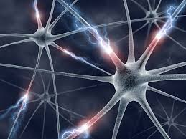
Neurons-you are born with a certain number…you get what your get!

Slide 48
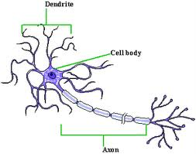
Neurons are Busy Cells!
Special
Transmitters- means they move like a train!

Slide 49
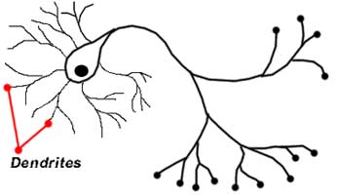
Dendrites-can grow the more you learn!

Slide 50
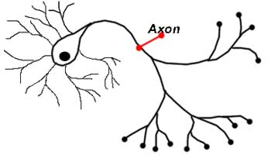
Axons are long fibers that send messages around the body.

Slide 51
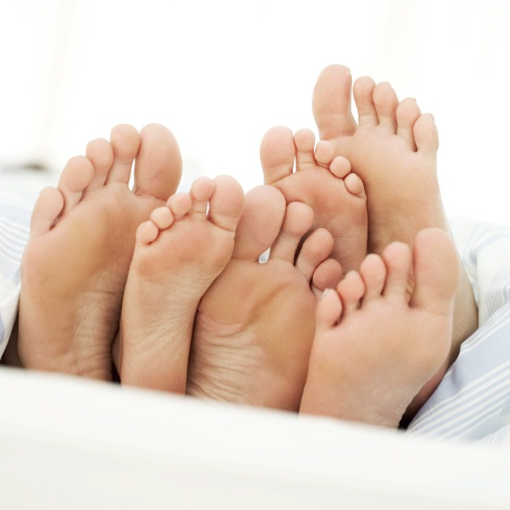
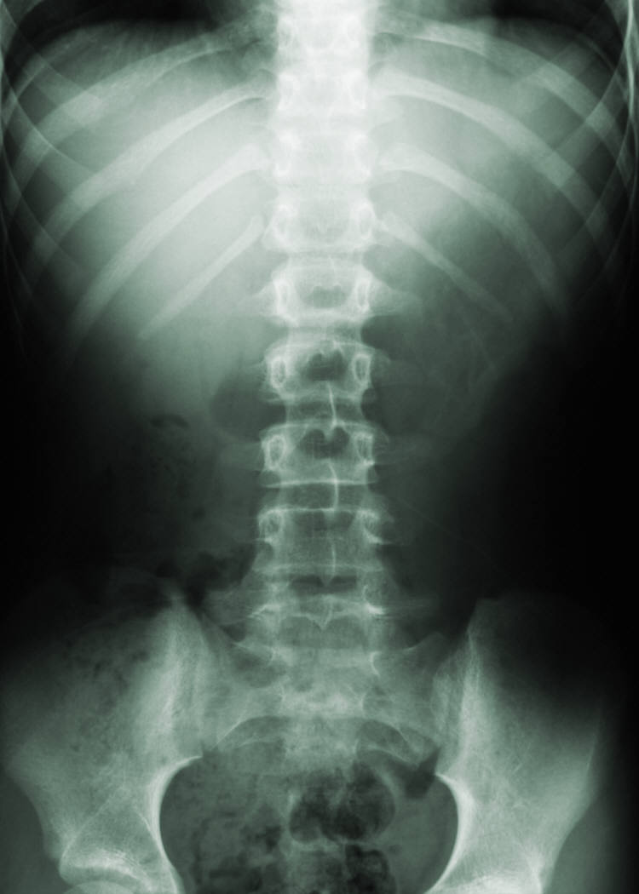

Your longest Axon is…

Slide 52
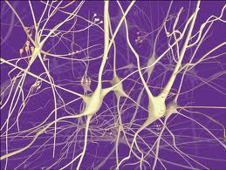
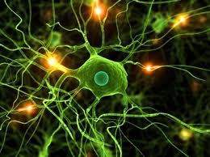
Neurons make connections
The more connections we make the more our brain grows!

Slide 53
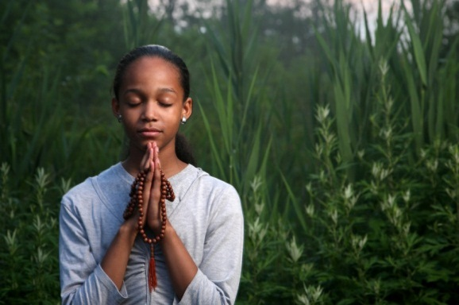



Calm Down and Release your Amygdala
https://www.youtube.com/watch?v=Zs559guIGDo

Slide 54


Slide 55

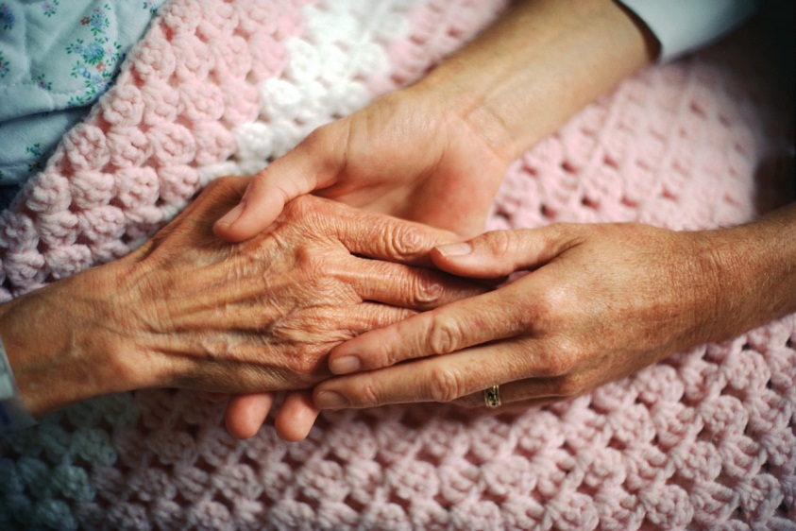

Slide 56
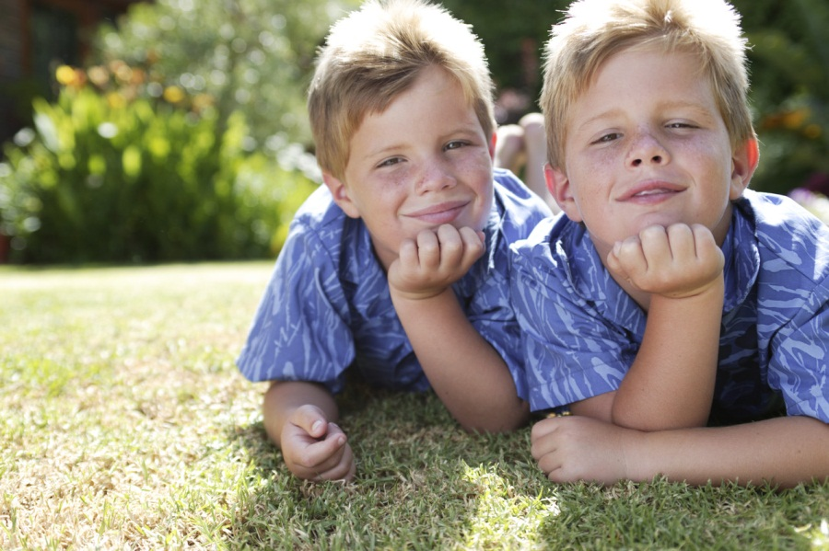
Focused Attention Breaks help us relax and learn more!

Slide 57
Quiet Relaxing Links
5 minute miracle
5 minutes off
Breathing Break
Mindfulness Break
5 minute breathing break
Music only

Slide 58
Remember …
Love your brain
Love yourself
Love your neighbor
Be kind
Be caring
Be loving and your brain will GROW!!!!!!

